Slide 1


Justin Coulter
August 16, 2023

Slide 2
Outline
Executive Summary
Introduction
Methodology
Results
Conclusion
Appendix

Slide 3
Executive Summary
Methodology
Retrieved SpaceX Public Launch Data
Classified successful and unsuccessful stage 1 rocket booster landing results
Corrected missing launch payload records to maximize dataset utilization
Applied data visualization techniques to identify causality
Generated maps highlighting landing results
Evaluated classification models for prediction accuracy
Created a dashboard for interactive data analysis
Results
Launch payload must determine the launch site and orbit type to maximize booster landing success
Landing success rate increases proportionally to the number of launches

Slide 4
Introduction
The new SpaceY company will begin offering public suborbital space flights at a competitive price point. The key to achieving this goal is to recover the stage 1 rocket booster post-launch whenever possible.
The challenges SpaceY faces are:
What payload ranges allow booster recovery
Which launch locations produce the highest launch success rate
Which recovery platforms are the most successful

Slide 5

Section 1

Slide 6
Methodology
Executive Summary
Data collection methodology:
Describe how data was collected
Perform data wrangling
Describe how data was processed
Perform exploratory data analysis (EDA) using visualization and SQL
Perform interactive visual analytics using Folium and Plotly Dash
Perform predictive analysis using classification models
How to build, tune, evaluate classification models

Slide 7
Data Collection
Data was collected from publicly available SpaceX previous launch records covering the following key points:
Stage 1 Rocket Booster Version
Rocket Launch Site
Rocket Launch Payload
Rocket Launch Landing Outcome
Empirical data was obtained via the following methods:
Calling the SpaceX REST API to retrieve JSON-formatted content
Web Scraping the https://en.wikipedia.org/wiki/List_of_Falcon_9_and_Falcon_Heavy_launches page

Slide 8
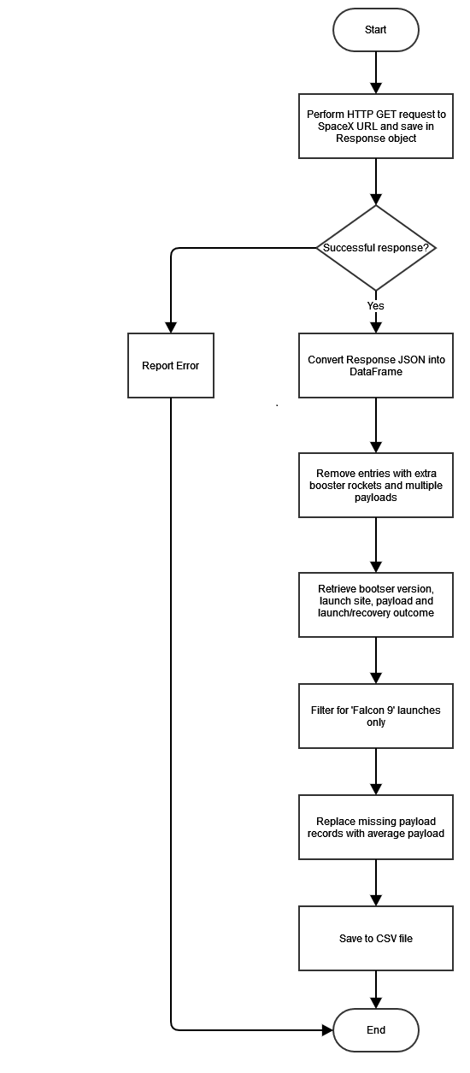
Data Collection – SpaceX API
Process
See flowchart at right for data collection process using the SpaceX API
GitHub Link
https://github.com/j1coulte/IBM_Data_Science/blob/main/Course10/week%201/jupyter-labs-spacex-data-collection-api.ipynb

Slide 9
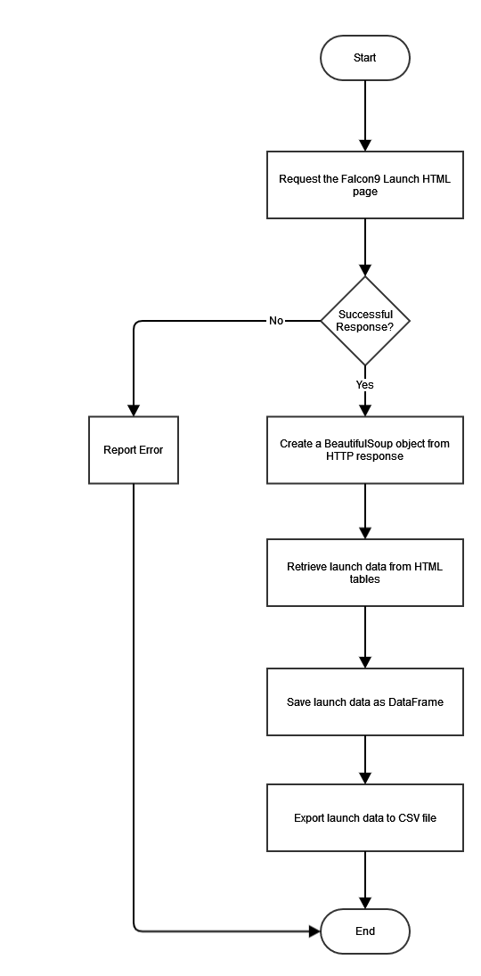
Data Collection - Scraping
Process
See flowchart at right for Web Scraping operation to collect SpaceX launch data
GitHub URL
https://github.com/j1coulte/IBM_Data_Science/blob/main/Course10/week%201/jupyter-labs-webscraping.ipynb

Slide 10
Data Wrangling
First Stage Rocket Booster Landing
CSV data imported from SpaceX REST API and Web Scraping collection phase
Data classified into successful and unsuccessful landing outcomes based upon
Launch Site
Orbit Type
Payload
Landing Success Rate Calculated
Saved as new Landing Class feature
Data exported as CSV file
GitHub URL
https://github.com/j1coulte/IBM_Data_Science/blob/main/Course10/week%201/labs-jupyter-spacex-Data%20wrangling.ipynb

Slide 11
EDA with Data Visualization
Graphs
Scatter Plot: Number of Flights per Launch Site
Demonstrated increased successful landing rate as flights increased at each launch site
Scatter Plot: Payload per Launch Site
Demonstrated launch site limitations for large (> 10,000 kg) payloads
Bar Chart: Launch Orbit Type and Landing Success Rate
Highest landing success rate for SSO, HEO, GEO and ES-L1 orbit types
Scatter Plot: Number of Flights per Orbit Type
Landing success rate increased for LEO, ISS and VLEO orbit types as the number of launches increased

Slide 12
EDA with Data Visualization (Cont’d)
Graphs
Scatter Plot: Payload per Orbit Type
Higher landing success rates
Heavy Payload (> 10,000kg): PO, VLEO and ISS orbit types
Light Payload (< 6,000kg): SSO and LEO orbit types
Line Chart: Landing Success Rate per Year
Significant success rate increase from 2013 to 2020
GitHub URL
https://github.com/j1coulte/IBM_Data_Science/blob/main/Course10/week%202/jupyter-labs-eda-dataviz.ipynb

Slide 13
EDA with SQL
SQL Queries
Retrieved all unique Launch Site names
Calculated the total payload from NASA launches (25,596kg)
Displayed the total payload launched by F9 v1.1 boosters (2928.4kg)
Retrieved the date of the first successful stage 1 booster landing (2015-12-22)
Retrieved the boosters carrying between 4000kg and 6000kg that successfully landed on a drone ship
Retrieved the total mission successful & unsuccessful launches/landings
Retrieved the booster versions that each carried the largest payload
Retrieved the month, booster version and launch site of failures in 2015

Slide 14
EDA with SQL (cont’d)
SQL Queries
Ranked the stage 1 rocket booster landing outcome between 2010-06-04 and 2017-03-2017
GitHub URL
https://github.com/j1coulte/IBM_Data_Science/blob/main/Course10/week%202/jupyter-labs-eda-sql-coursera_sqllite.ipynb

Slide 15
Build an Interactive Map with Folium
Map
Folium Map: centered on NASA Johnson Space Center in Houston, Texas
Map Objects
A Circle was added to the map to outline each Launch Site’s region
A Marker was added to the map to pinpoint each Launch Site’s coordinates
A MarkerCluster was added to the map to indicate each launch outcome
Success: green Marker
Failure: red Marker
A MousePosition was added to the map to display mouse position map coordinates
A PolyLine was added to the map to show the distance between a launch site (Marker) and the nearest coastline point
A PolyLine was added to the map to show the distance between a launch site and the nearest city (Marker)

Slide 16
Build an Interactive Map with Folium
Inferences
Launch sites are located close to railways for resupply purposes
Launch sites are located away from population centers and near coastlines for safety reasons
GitHub URL
https://github.com/j1coulte/IBM_Data_Science/blob/main/Course10/week%203/lab_jupyter_launch_site_location.ipynb

Slide 17
Build a Dashboard with Plotly Dash
Dashboard
Default state
Pie graph displaying the percentage of successful launches for each of the four launch sites
Scatter plot displaying launch outcomes for all payloads, grouped by booster version
Dropdown list
Allows the User to select a specific launch site
Specific Site
Pie graph displays the launch site’s launch outcome
Scatter plot of payload compared to launch outcomes for each booster version
Range slider allows the User to select a specific payload range
GitHub URL
https://github.com/j1coulte/IBM_Data_Science/blob/main/Course10/week%203/spacex_dash_app.py

Slide 18
Predictive Analysis (Classification)
Two datasets were imported from CSV files
Flight data including orbit type and booster characteristics features
Flight landing outcomes (success or failure) feature
Data standardization
Flight data features standardized and transformed to align with flight landing outcomes
Training and Testing Datasets
20% of dataset allotted to testing each model with a random state of 2

Slide 19
Predictive Analysis (Classification)
Models
Logistic Regression
Training Set
Best hyperparameters: C = 0.01, penalty = 12, solver = lbfgs
Accuracy: 0.846
Test Set
Accuracy: 0.833
Support Vector Machine
Training Set
Best hyperparameters: C = 1.0, gamma = 0.031, kernel = sigmoid
Accuracy: 0.848
Test Set
Accuracy: 0.8333

Slide 20
Predictive Analysis (Classification) – cont’d
Models (cont’d)
Decision Tree
Training Set
Best hyperparameters
criterion = gini
max_depth = 12
max_features = sqrt
min_samples_leaf = 4
min_samples_split = 10
splitter = random
Accuracy: 0.887
Test Set
Accuracy: 0.666

Slide 21
Predictive Analysis (Classification) – cont’d
Models (cont’d)
K Nearest Neighbors
Training Set
Best hyperparameters: algorithm = ball_tree, n_neighbors = 10, p = 1
Accuracy: 0.848
Test Set
Accuracy: 0.833
GitHub URL
https://github.com/j1coulte/IBM_Data_Science/blob/main/Course10/week%204/SpaceX_Machine_Learning_Prediction_Part_5.jupyterlite.ipynb

Slide 22
Results
Exploratory data analysis results
Number of Flights per Launch Site
Demonstrated increased successful landing rate as flights increased at each launch site
Payload per Launch Site
Demonstrated launch site limitations for large (> 10,000 kg) payloads
Launch Orbit Type and Landing Success Rate
Highest landing success rate for SSO, HEO, GEO and ES-L1 orbit types
Number of Flights per Orbit Type
Landing success rate increased for LEO, ISS and VLEO orbit types as the number of launches increased

Slide 23
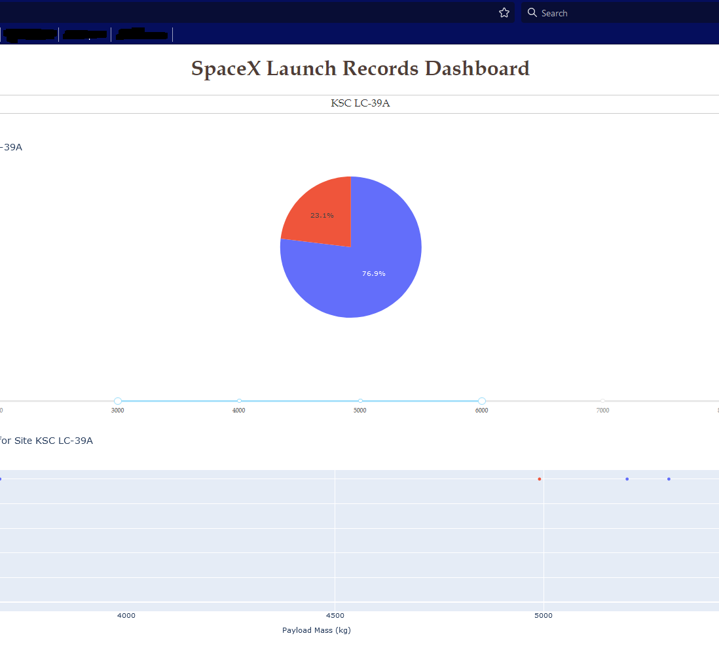
Results (cont’d)
KSC LC-39A
Overall Landing success rate
Landing success rate based upon a payload range for each booster version

Slide 24
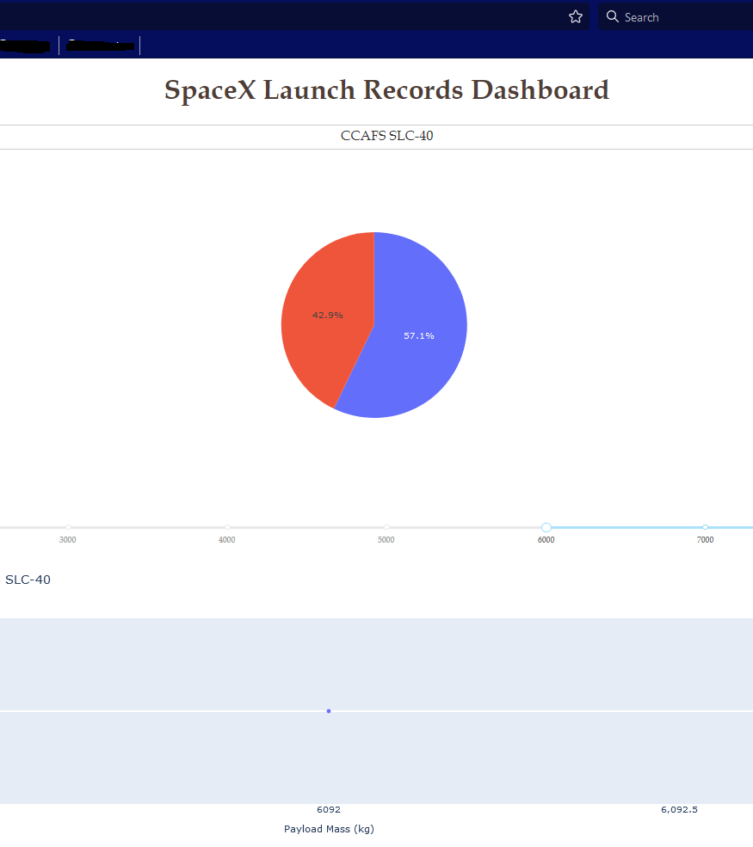
Results (cont’d)
CCAFS SLC-40
Overall Landing success rate
Landing success rate based upon a payload range for each booster version

Slide 25
Results (cont’d)
Predictive analysis results
Training Set Accuracy
Highest: Decision Tree (88.7%)
Lowest: Logistic Regression (84.6%)
Test Set Prediction Accuracy
Highest: KNN, SVM, Logistic Regression (83.3%)
Lowest: Decision Tree (66.7%)
Increased the number of false negatives compared to other models
Conclusion
KNN or SVM models will provide the best combination of accuracy and prediction

Slide 26

Section 2

Slide 27
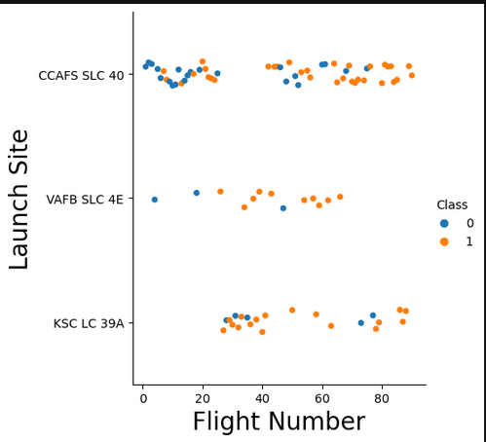
Flight Number vs. Launch Site
Successful Launch Landings increased for all three launch sites as the number of launches increased
CCAFS SLC 40 experienced the most overall launches
Predominately the launch site used for the first 25 or so launches
VAFB SLC 4E
Fewest number of launches

Slide 28
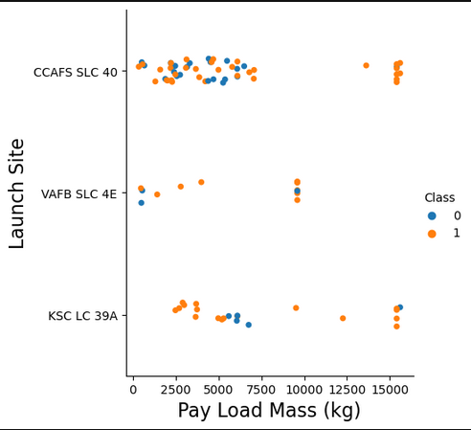
Payload vs. Launch Site
High landing success rate for heavy payload (> 10,000kg) launches on all three sites
High landing failure rate at CCAFS SLC 40 for light payload (< 6,000kg) launches
VAFB SLC 4E not used for heavy payload (> 10,000kg) launches

Slide 29
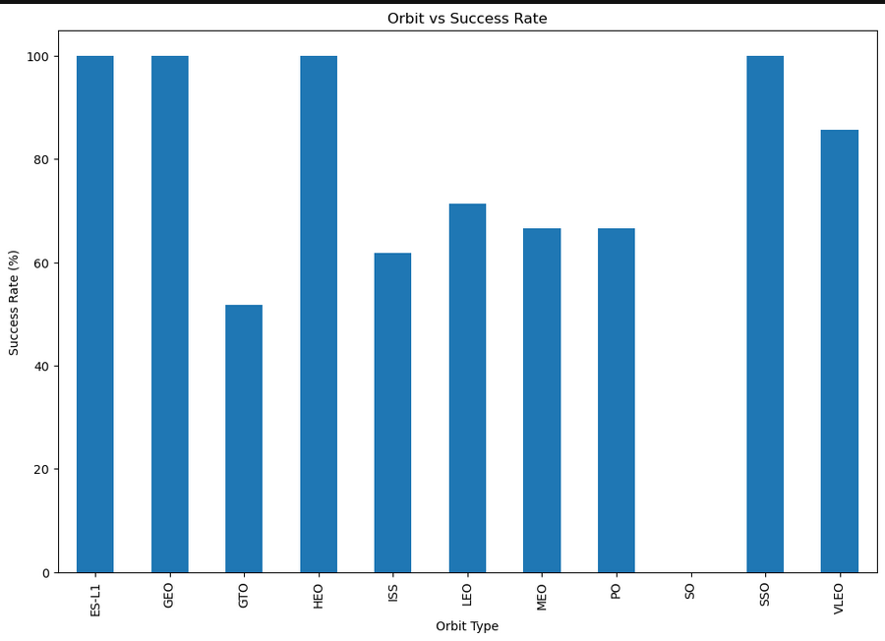
Success Rate vs. Orbit Type
Highest landing success rates
SSO
HEO
GEO
ES-L1
Lowest landing success rates
GTO
ISS

Slide 30
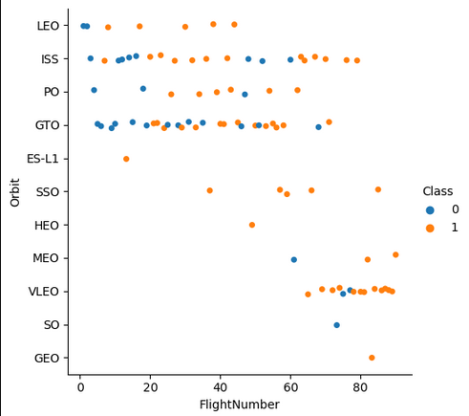
Flight Number vs. Orbit Type
Landing success rate increases as the number of flights increase
ISS
LEO
VLEO
Dominant Orbit Types
LEO
ISS
GTO

Slide 31
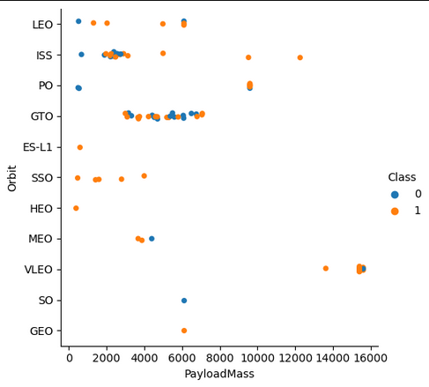
Payload vs. Orbit Type
Light Payload (< 6000kg)
SSO orbit type yields most successful landings
ISS & GTO types yield most unsuccessful landings
Heavy Payload (> 10,000kg)
Dominated by ISS, PO and VLEO orbit types
ISS and PO more successful at landing than with light payload launches

Slide 32
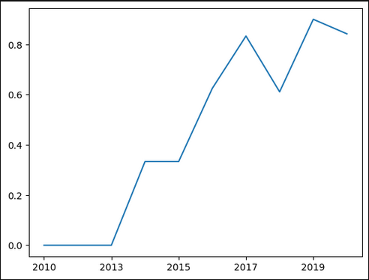
Launch Success Yearly Trend
Successful landings increased significantly between 2013 and 2020
Successful landings regressed in 2018 and 2020 compared to their respective prior years

Slide 33
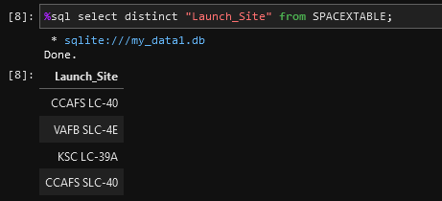
All Launch Site Names
Find the names of the unique launch sites
The SPACEXTABLE was created from a DataFrame
The DataFrame imported the SpaceX launch results in CSV file format
The query specified the ‘Launch_Site’ column and the keyword distinct ensured only unique launch site names were retrieved in the result

Slide 34
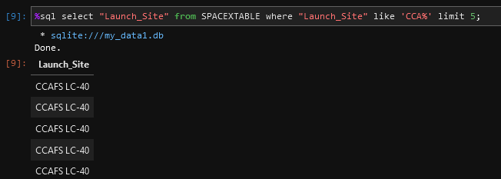
Launch Site Names Begin with 'CCA'
Find 5 records where launch sites begin with `CCA`
The ‘Launch_Site’ column was retrieved with the condition that it must begin with the “CCA” string and the limit keyword was specified to return only the first five records from the table

Slide 35
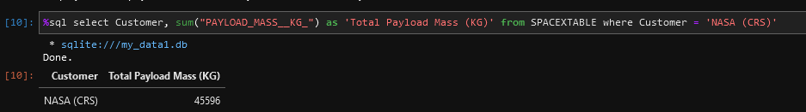
Total Payload Mass
Calculate the total payload carried by boosters from NASA
Retrieved all records for the Customer “NASA (CRS)” payload, calling the sum operator on the payload column of all returned records and displaying this information in tabular form

Slide 36
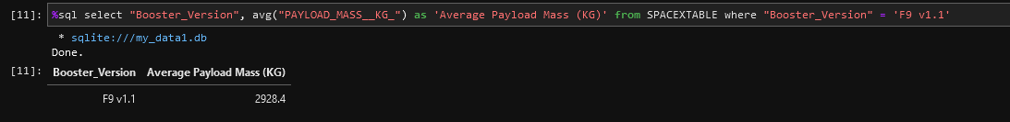
Average Payload Mass by F9 v1.1
Calculate the average payload carried by F9 v1.1 boosters
Retrieve all records for “F9 v1.1” booster version and calculate the average payload upon the returned records using the avg function call

Slide 37
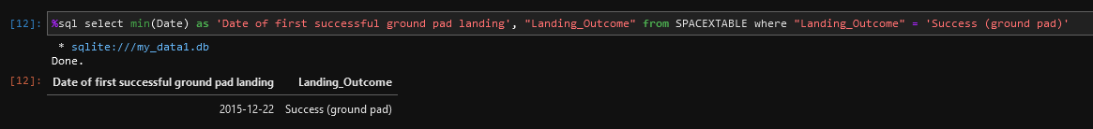
First Successful Ground Landing Date
Find the dates of the first successful landing outcome on ground pad
Retrieve all records of successful landings and display the record with the minimum date using the min function

Slide 38
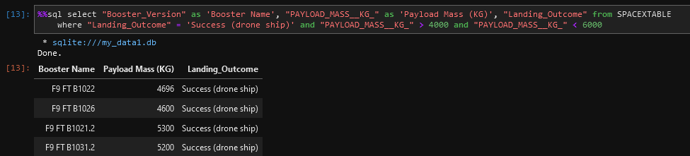
Successful Drone Ship Landing with Payload between 4000 and 6000
List the names of boosters which have successfully landed on drone ship and had payload mass greater than 4000 but less than 6000
Retrieve all records with payload between 4000kg and 6000kg (using the ‘>’ and ‘<‘ operators), and display the booster name, payload and outcome of these records in tabular form

Slide 39
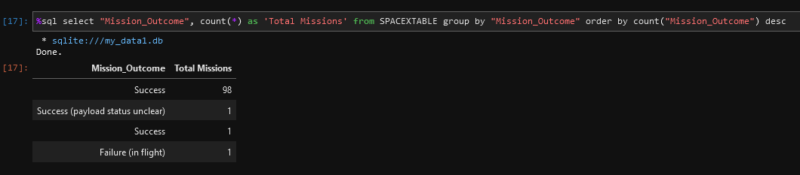
Total Number of Successful and Failure Mission Outcomes
Calculate the total number of successful and failure mission outcomes
Retrieve all records, grouped by mission outcome and display the total missions for each outcome in tabular form

Slide 40
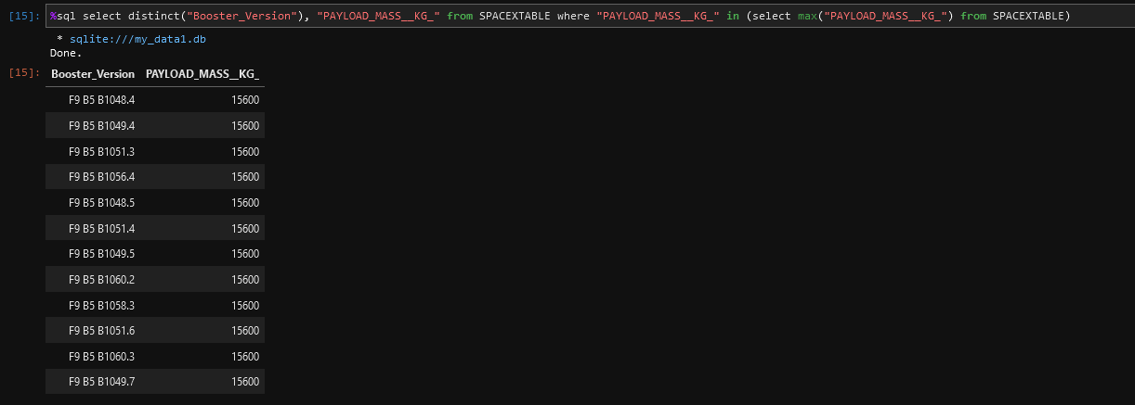
Boosters Carried Maximum Payload
List the names of the booster which have carried the maximum payload mass
Retrieve only those unique records containing the maximum payload for each booster version and display in tabular form

Slide 41
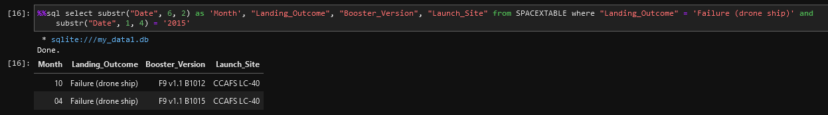
2015 Launch Records
List the failed landing_outcomes in drone ship, their booster versions, and launch site names for in year 2015
Retrieve only those records that contain a failure to land on a drone ship in the year 2015, and display the month, landing outcome, booster version and launch site in tabular form

Slide 42
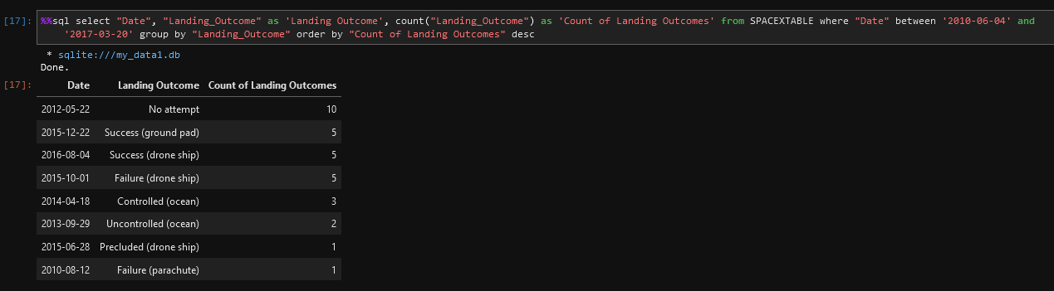
Rank Landing Outcomes Between 2010-06-04 and 2017-03-20
Rank the count of landing outcomes (such as Failure (drone ship) or Success (ground pad)) between the date 2010-06-04 and 2017-03-20, in descending order
Retrieve only those records in the date range, grouped by landing outcome and ordered by landing outcome in descending order.
Display the date, landing outcome and cardinality of each landing outcome (in descending order) in tabular form

Slide 43

Section 3

Slide 44
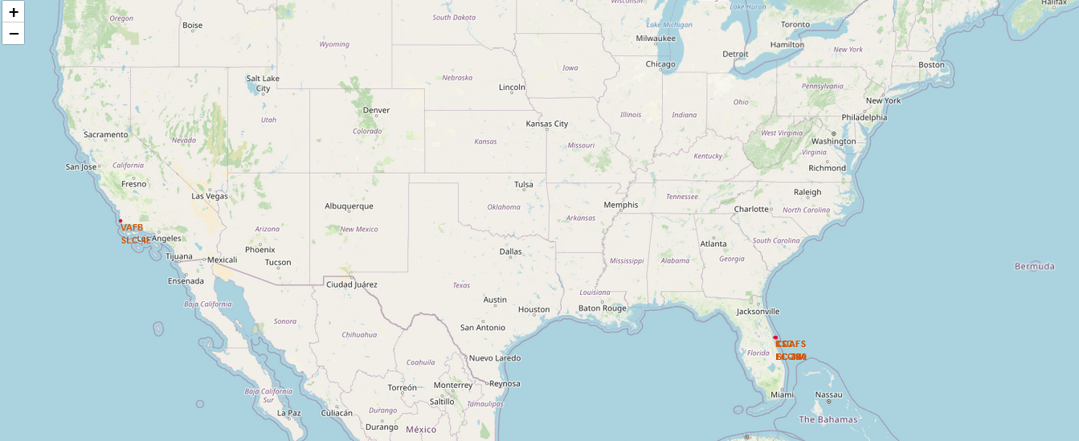
All Launch Sites
Each launch site consists of
A Circle object displaying a shaded radius of 1000 from the center point
A Marker object pinpointing the exact coordinates

Slide 45
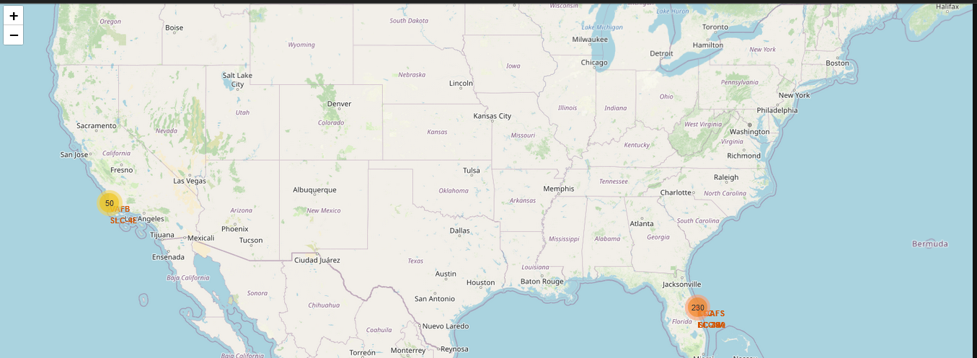
Launch Outcomes per Launch Site
The state of Florida has nearly 5 times the number of launches compared to the state of California
The CCAFS LC-40 site has the most launches (130) but also has the highest failure rate

Slide 46
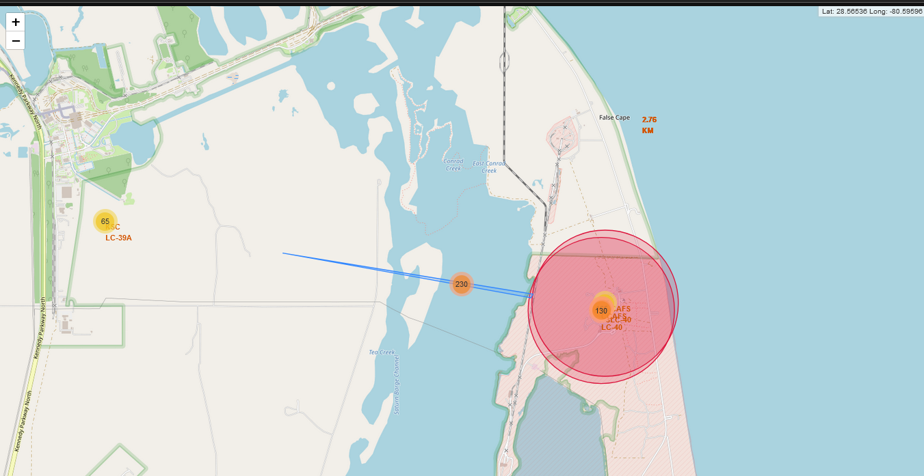
Launch Site to Proximities
Launch sites are located near coast lines to facilitate safer rocket booster recovery efforts in the ocean
Launch sites are located away from population centers (cities, highways) to reduce casualties from failed launches
Launch sites are located near railways to assist with resupply efforts

Slide 47

Section 4

Slide 48
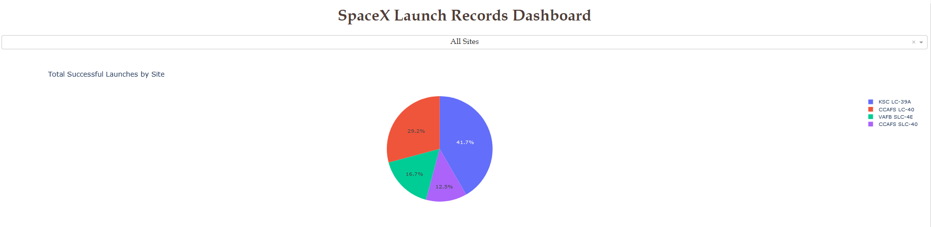
Total Successful Launches for All Launch Sites
Launch site ‘KSC LC-39A’ had the highest landing success rate
Launch site ‘CCAFS SLC-40’ had the lowest landing success rate

Slide 49
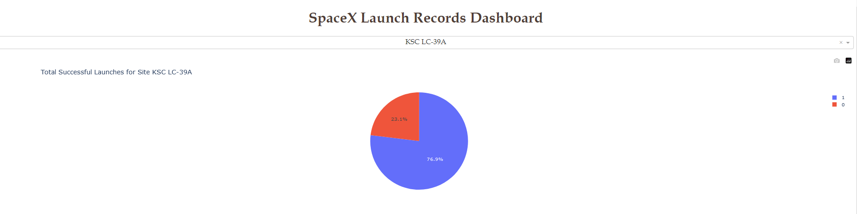
Successful Landings from KSC LC-39A
There were 10 successful landings from this launch site
There were 3 unsuccessful landings from this launch site

Slide 50
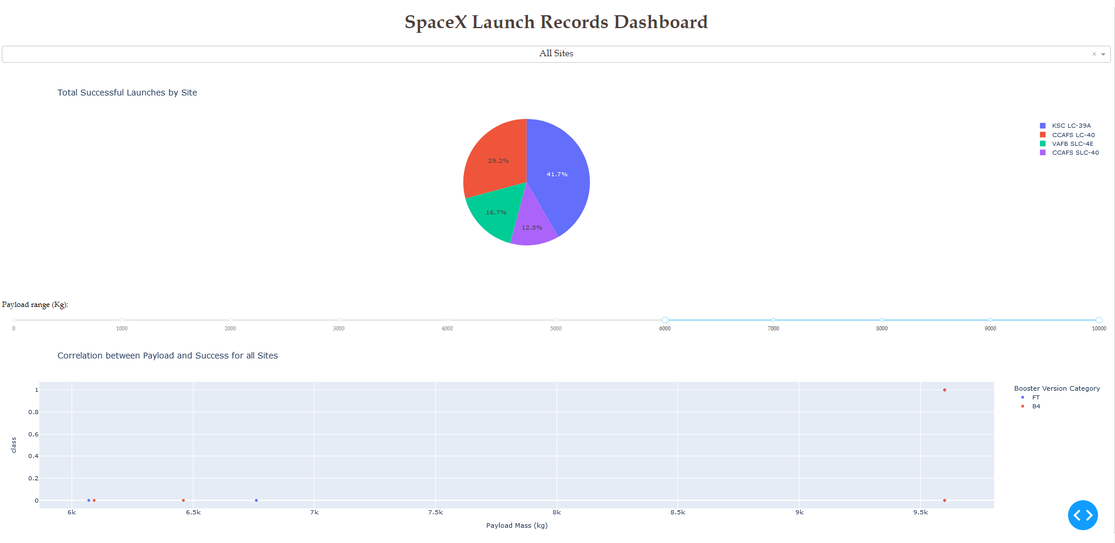
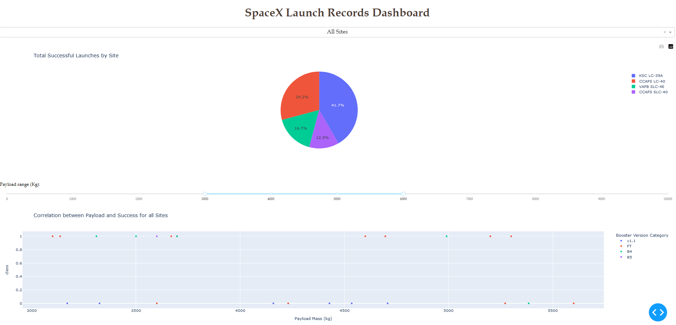
All Sites Success for Various Payload Ranges
The B4 booster had the highest success rate for heavier payloads (6000kg – 10000kg)
The FT booster had the highest success rate for lower payloads (3000kg – 6000kg)

Slide 51

Section 5

Slide 52
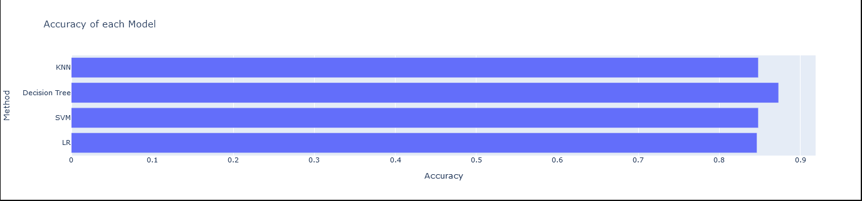
Classification Accuracy
Visualize the built model accuracy for all built classification models, in a bar chart
The Decision Tree model has a slightly higher accuracy value for the training data

Slide 53
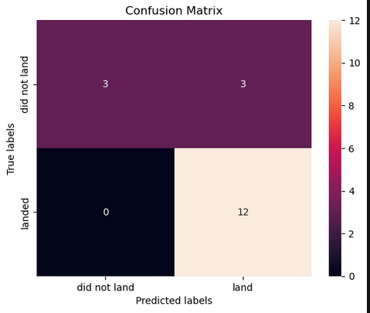
Confusion Matrix
The Logistic Regression, Support Vector Machine, and K-Nearest Neighbors models all had the highest prediction accuracy
The Decision Tree model produced fewer false positives (2) and more false negatives (3) than the other models

Slide 54
Conclusions
SpaceY launch payload should dictate launch site and orbit type for optimal landing success rate
Less than 10,000kg
VAFB SLC 4E
Fewer SpaceX launches (lower scheduling contention) compared to CCAFS SLC 40 and KSC LC 39A
Higher launch landing rate compared to CCAFS SLC 40 and KSC LC 39A
SSO orbit
Over 10,000kg
KSC LC 39A
Fewer SpaceX launches (lower scheduling contention) compared to CCAFS SLC 40
Similar launch landing success rate
ISS, PO or VLEO
Space Y Rocket Booster Stage 1 Landing Prediction
Logistic Regression, Support Vector Machine, and K-Nearest Neighbors models all yielded the highest prediction accuracy
Landing success rate increases proportionally to the number of launches

Slide 55
Appendix
All Jupyter Notebooks and Python scripts located under the https://github.com/j1coulte/IBM_Data_Science/tree/main/Course10 repository

Slide 56


